Slide 1
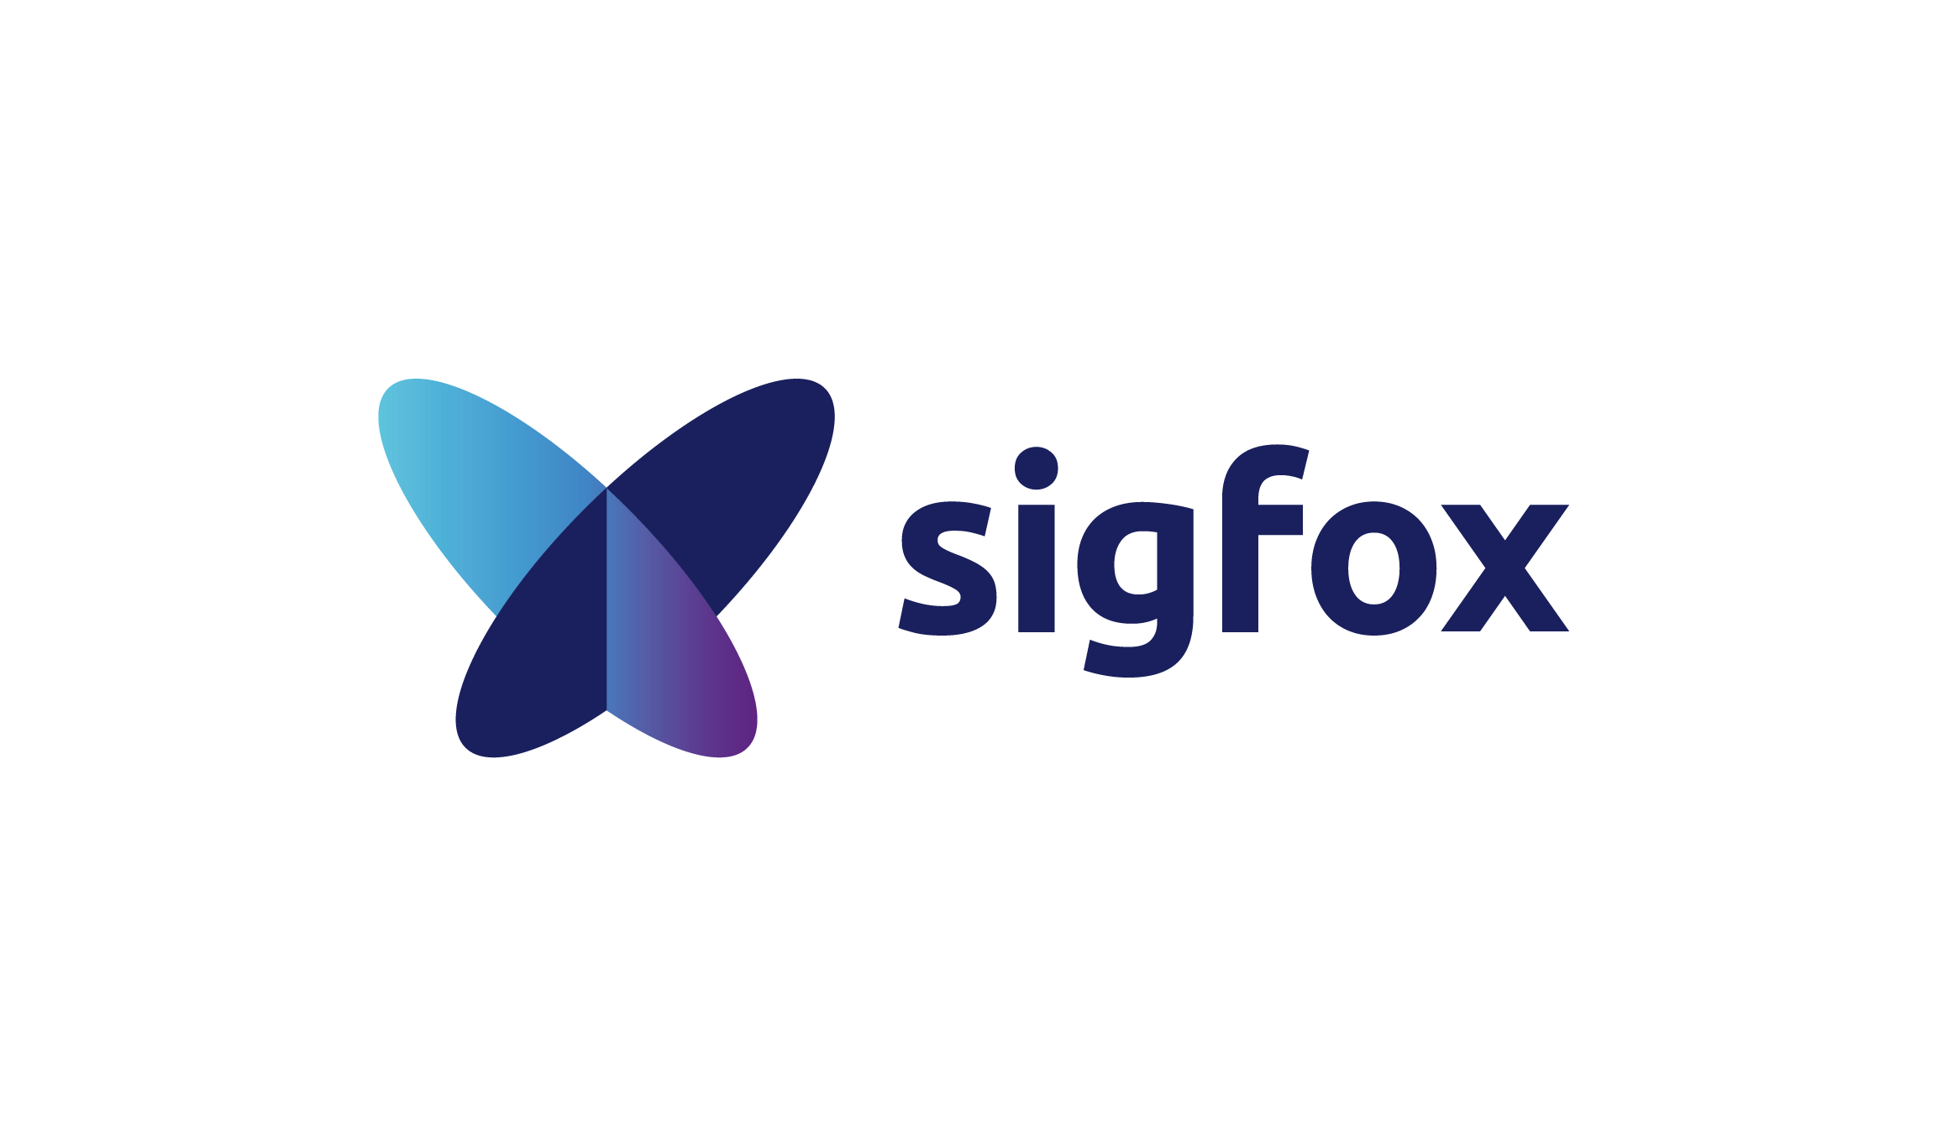
Cristina GUTTUSO
General Counsel
Sigfox
Impact of GDPR on the development of the IoT

Slide 2
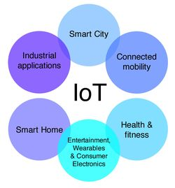
IoT and the data economy
IoT is an industry with heavy focus on data collection, data analytics and data monetization
Not all IoT use cases are about personal data:
  Industrial IoT: manufacturing, logistics, transportation
  Consumer IoT: smart homes, wearables, healthcare

Slide 3

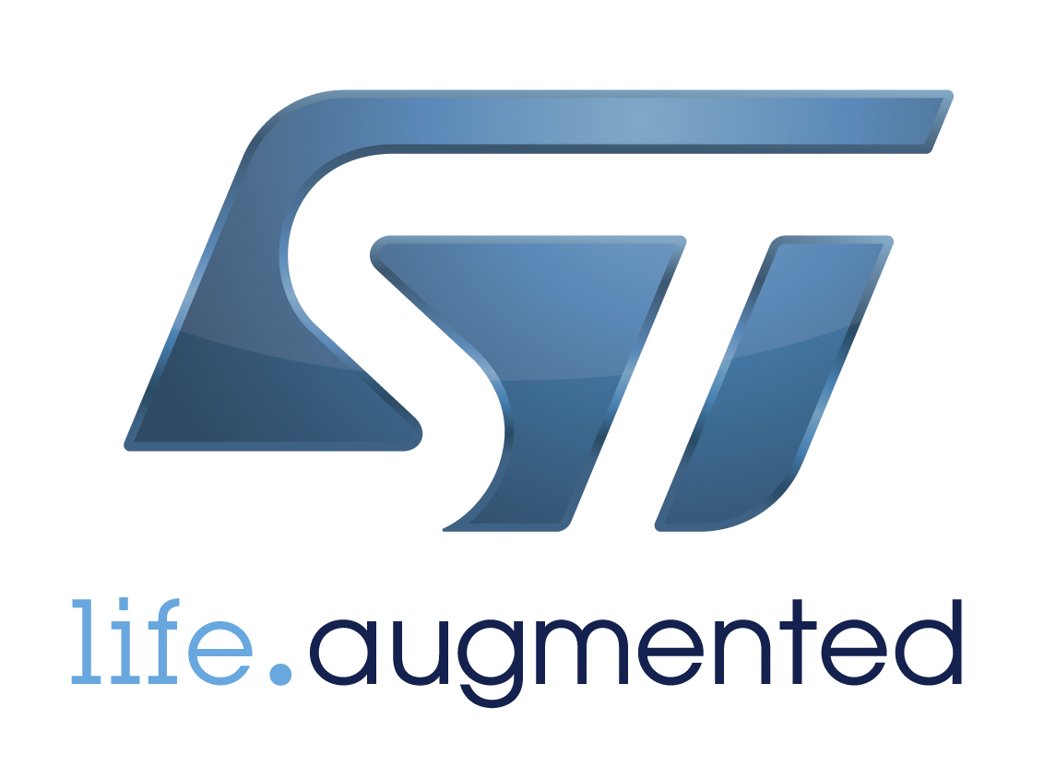


























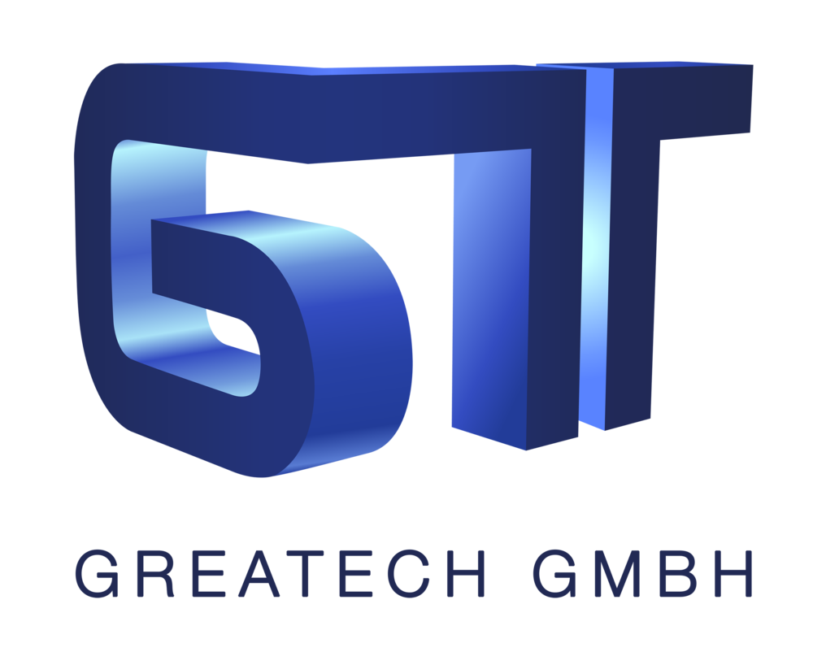







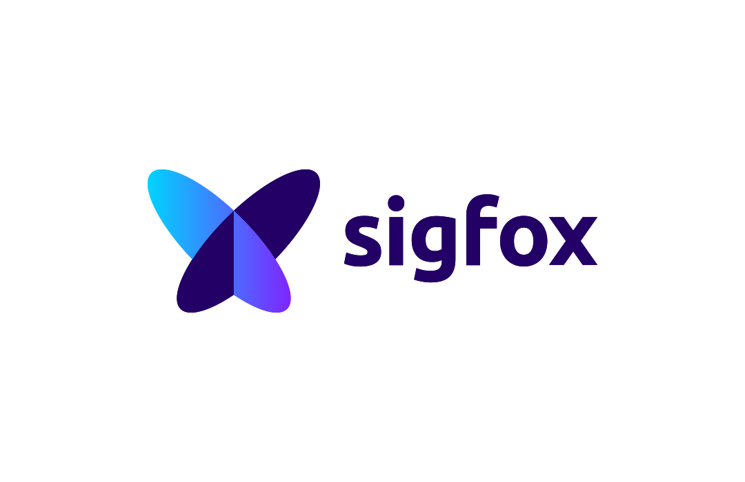



Industrial IoT value chain - Sigfox in the ecosystem
Device maker
IoT Service Provider
IoT Platforms
Solution Integration
Customer
or Consumer
Device Maker
Network Operator
Cloud Operator
Solution Maker
IoT agency
IOT Infrastructure
IOT Connectivity

Slide 4
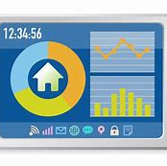
Industrial IoT use cases and personal data
Smart Metering
Collection of energy consumption data

Slide 5

Industrial IoT use cases and personal data
Asset Tracking (connected luggage)
Collection of location data

Slide 6

IoT and personal data: a confession of failure?
According to a research conducted by 25 data protection regulators worldwide in end of 2016 :
59% of IoT devices failed to explain to users how they process user data
68% failed to explain how they store information
72% failed to explain how to delete data
38% failed to include contact information
The study looked at devices like internet-connected thermostats and watches that monitor health.

Slide 7
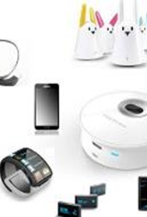
IoT – risks and drifts
Lack of control of the data subject on usage and destination of his/her data
Profiling and increasing the marketing profile of the individual
Develop a form of surveillance of individuals

Slide 8
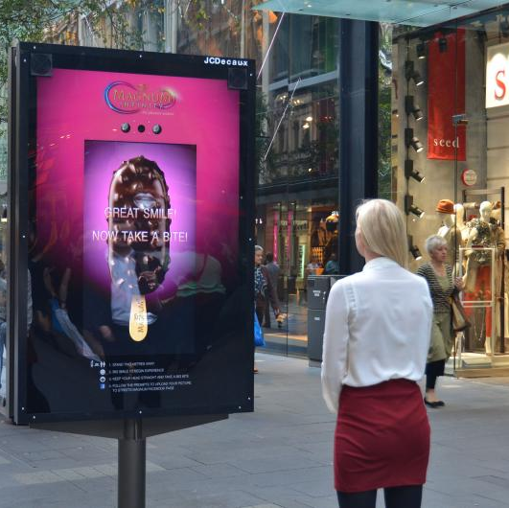

GDPR and new challenges for the IoT
Consent ➔ specific, informed, unambiguous and free
Data Protection Impact Assessment ➔ systematically

Slide 9

GDPR and new challenges for the IoT
Information of data subjects in a concise, transparent, intelligible and easily accessible form, using clear and plain language
New rights of data subjects : to erasure, to data portability, to object, including to profiling

Slide 10
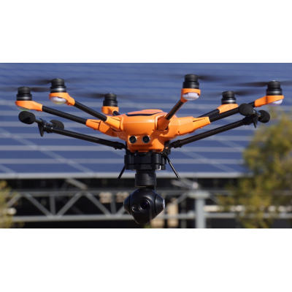
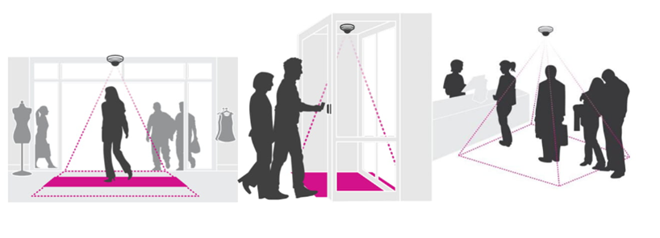
GDPR and new challenges for the IoT
Privacy by design – Privacy by default
Should IoT providers opt for less « intrusive » technologies? SmartRetail: infrared or thermal imaging sensors instead of video or wifi ?
➔ How to guarantee security by default in a fragmented value chain?

Slide 11

GDPR and new challenges for the IoT
Accountability
Multiple subcontractors and ecosystem fragmentation
Liabilities and direct sanctions

Slide 12
MERCI - THANK YOU!
Cristina Guttuso
Email: cristina.guttuso@sigfox.com
Phone: +33 6 49 31 98 49

